Slide 1

CSE 471 Machine Learning
Logistic Regression
Prepared by
Madhusudan Basak
Assistant Professor
CSE, BUET

Slide 2
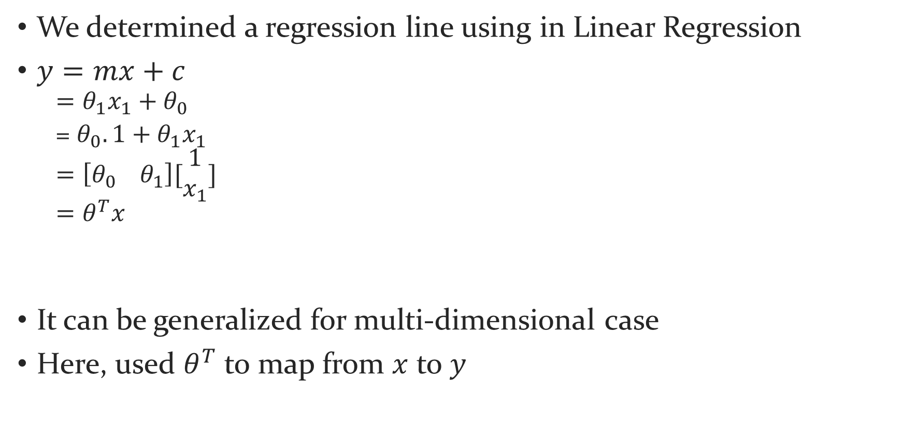
Background
We determined a regression line using in Linear Regression
$y=mx+c$
$$=θ_{1}x_{1}+θ_{0}$$
= $θ_{0}.1+θ_{1}x_{1}$
$$=\left[θ_{0} θ_{1}\right][\begin{matrix}1 \\ x_{1}\end{matrix}]$$
$$=θ^{T}x$$
It can be generalized for multi-dimensional case
Here, used $θ^{T}$ to map from $x$ to $y$

Slide 3
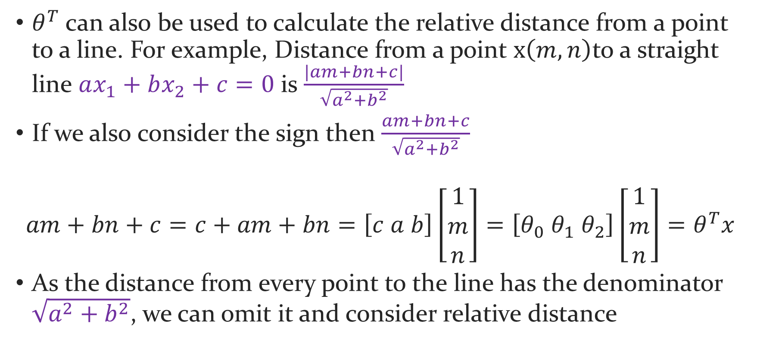
Background
$θ^{T}$ can also be used to calculate the relative distance from a point to a line. For example, Distance from a point $x\left(m,n\right)$to a straight line $ax_{1}+bx_{2}+c=0$ is $\frac{|am+bn+c|}{\sqrt{a^{2}+b^{2}}}$
If we also consider the sign then $\frac{am+bn+c}{\sqrt{a^{2}+b^{2}}}$
$$am+bn+c=c+am+bn=\left[c a b\right]\left[\begin{matrix}1 \\ m \\ n\end{matrix}\right]=\left[θ_{0} θ_{1} θ_{2}\right]\left[\begin{matrix}1 \\ m \\ n\end{matrix}\right]=θ^{T}x$$
As the distance from every point to the line has the denominator $\sqrt{a^{2}+b^{2}}$, we can omit it and consider relative distance

Slide 4

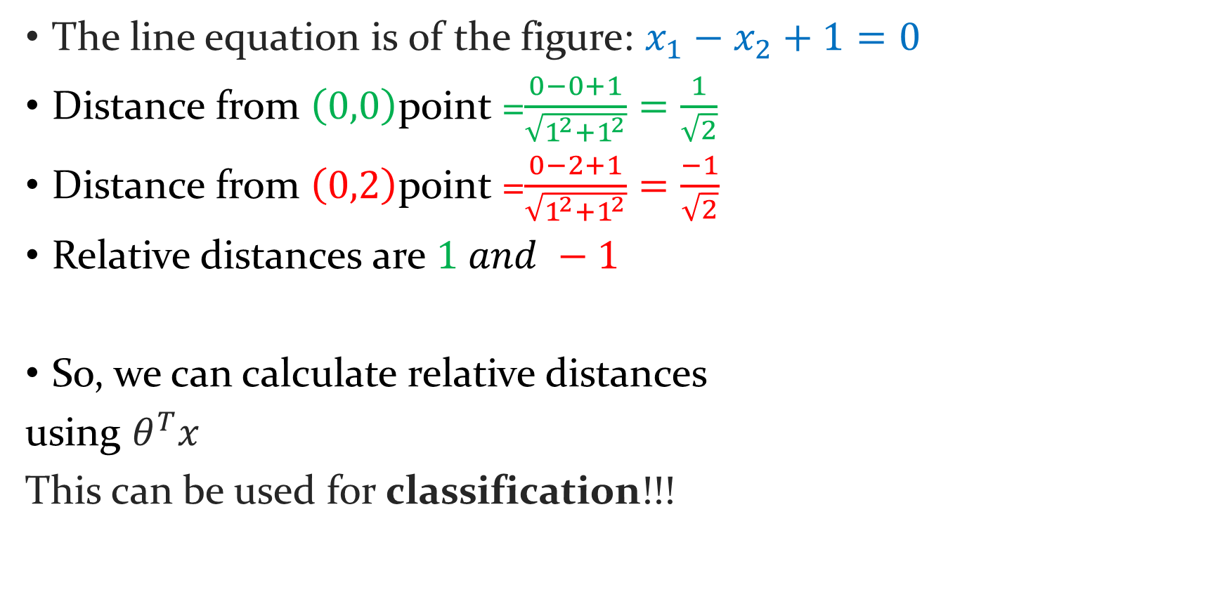

Background
The line equation is of the figure: $x_{1}−x_{2}+1=0$
Distance from $\left(0,0\right)$point =$\frac{0−0+1}{\sqrt{1^{2}+1^{2}}}=\frac{1}{\sqrt{2}}$
Distance from $\left(0,2\right)$point =$\frac{0−2+1}{\sqrt{1^{2}+1^{2}}}=\frac{−1}{\sqrt{2}}$
Relative distances are $1 and −1$
So, we can calculate relative distances
using $θ^{T}x$
This can be used for classification!!!
$$x_{2}$$
(0,2)
(0,1)
(0,0)
$$x_{1}$$

Slide 5
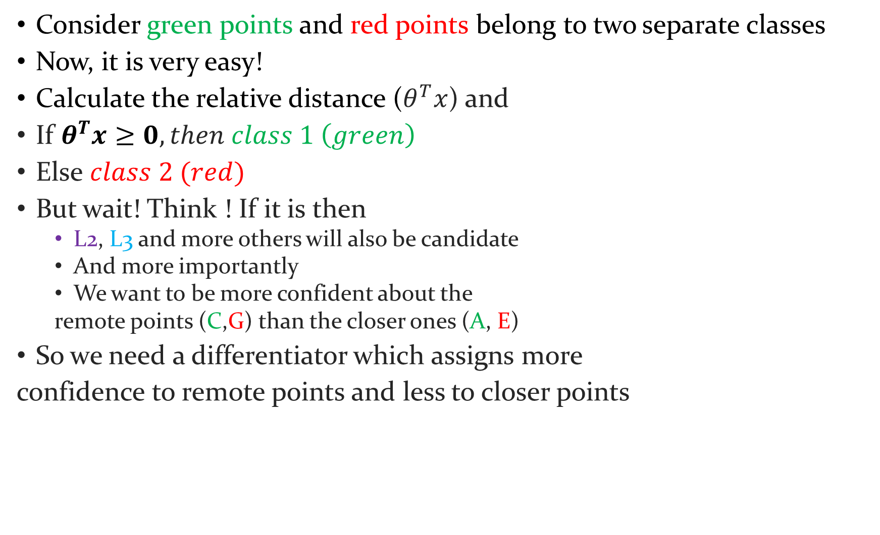
Background
Consider green points and red points belong to two separate classes
Now, it is very easy!
Calculate the relative distance ($θ^{T}x$) and
If $θ^{T}x≥0, then class 1 \left(green\right)$
Else $class 2 (red)$
But wait! Think ! If it is then
L2, L3 and more others will also be candidate
And more importantly
We want to be more confident about the
remote points (C,G) than the closer ones (A, E)
So we need a differentiator which assigns more
confidence to remote points and less to closer points
G
$$x_{2}$$
F
H
E
L3
A
D
L1
B
$$x_{1}$$
C
L2

Slide 6
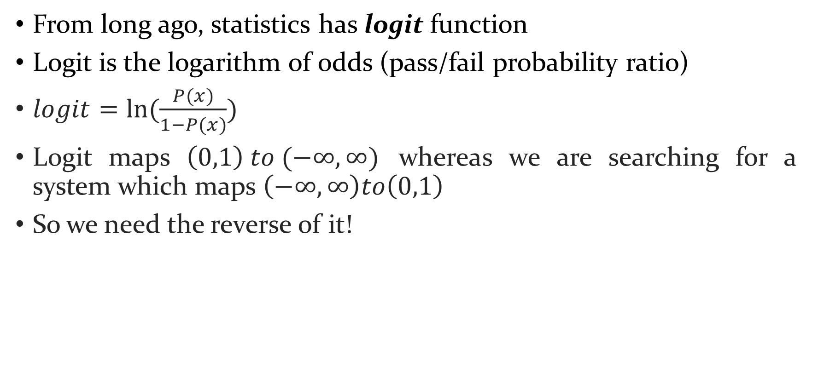
In search of a soft differentiator
From long ago, statistics has logit function
Logit is the logarithm of odds (pass/fail probability ratio)
$logit=ln⁡(\frac{P(x)}{1−P(x)})$
Logit maps $\left(0,1\right) to (−∞,∞)$ whereas we are searching for a system which maps $\left(−∞,∞\right)to\left(0,1\right)$
So we need the reverse of it!

Slide 7
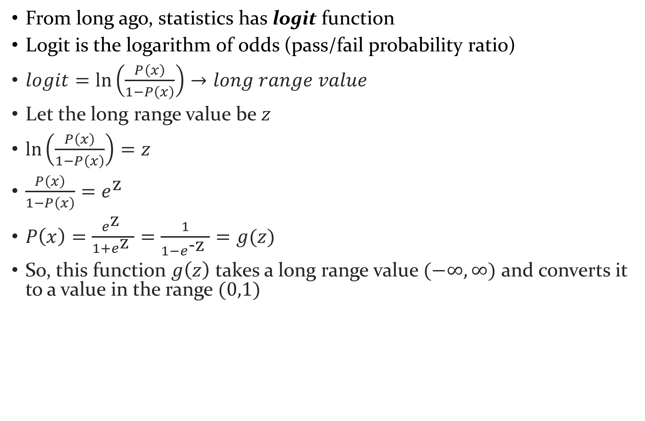
In search of a soft differentiator
From long ago, statistics has logit function
Logit is the logarithm of odds (pass/fail probability ratio)
$logit=\ln\left(\frac{P\left(x\right)}{1−P\left(x\right)}\right)→long range value$
Let the long range value be $z$
$\ln\left(\frac{P\left(x\right)}{1−P\left(x\right)}\right)=z$
$\frac{P\left(x\right)}{1−P\left(x\right)}=e^{\text{z} }$
$P\left(x\right)=\frac{e^{\text{z} }}{1+e^{\text{z} }}=\frac{1}{1−e^{\text{−}\text{z} }}=g(z)$
So, this function $g\left(z\right)$ takes a long range value $(−∞,∞)$ and converts it to a value in the range $(0,1)$

Slide 8
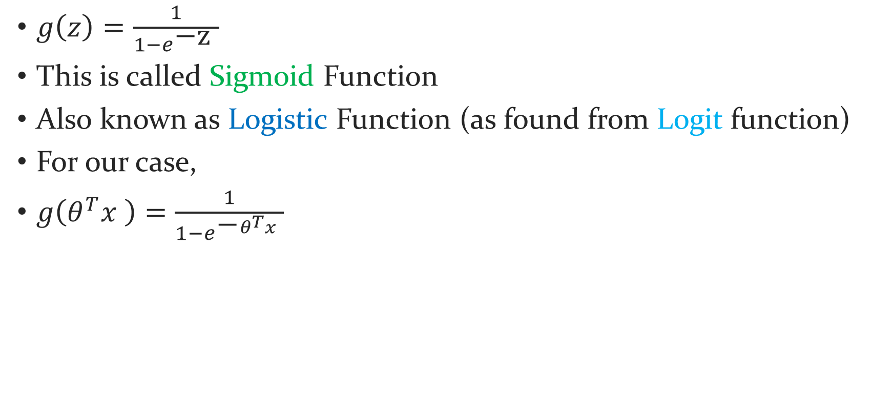
Found our soft differentiator
$g\left(z\right)=\frac{1}{1−e^{\text{−}\text{z} }}$
This is called Sigmoid Function
Also known as Logistic Function (as found from Logit function)
For our case,
$g\left(θ^{T}x \right)=\frac{1}{1−e^{\text{−}θ^{T}x }}$

Slide 9
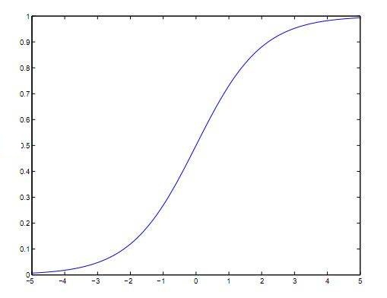


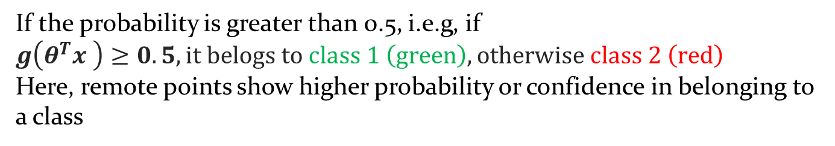

Sigmoid Function
$g\left(θ^{T}x \right)=\frac{1}{1−e^{\text{−}θ^{T}x }}$
D
B
C
A
G
$$x_{2}$$
F
y
H
E
Class
F
E
H
G
A
D
L1
B
$$x_{1}$$
θ ^{T}x
C
If the probability is greater than 0.5, i.e.g, if $g\left(θ^{T}x \right)≥0.5, it belogs to class 1 \left(green\right), otherwise class 2 \left(red\right)$
Here, remote points show higher probability or confidence in belonging to a class

Slide 10
Sigmoid Function
$g\left(θ^{T}x \right)=\frac{1}{1−e^{\text{−}θ^{T}x }}$
B
D
C
A
G
$$x_{2}$$
F
y
E
H
H
E
Class
F
L2
G
A
D
B
$$x_{1}$$
θ ^{T}x
C
Our main target now: Find the best separator line!

Slide 11
Finding the best separator
For (linear) regression, we minimized the error or cost function
Here, we shall maximize the probability (of each point to be assigned in its respective class)
You can put a minus sign in the upcoming maximizing equation, consider it the cost and minimize it

Slide 12
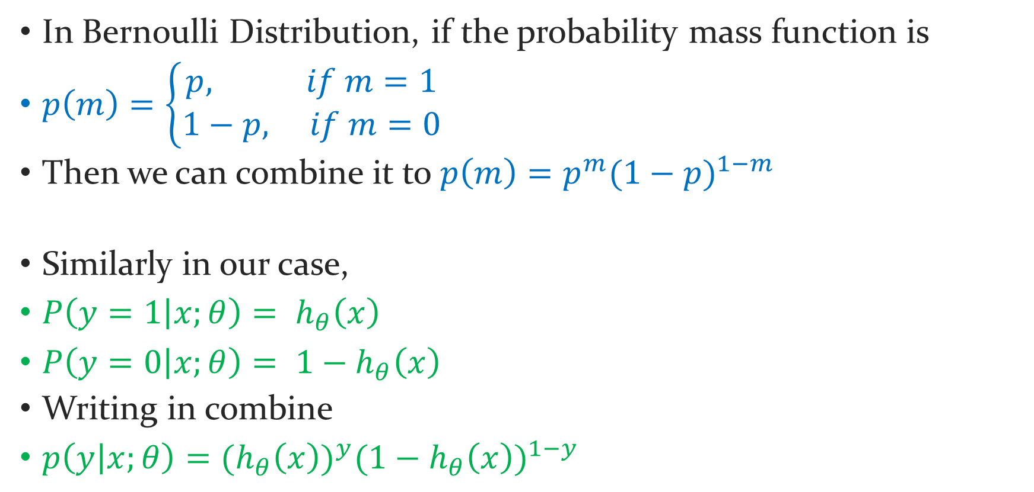
Maximizing the probability
In Bernoulli Distribution, if the probability mass function is
$p\left(m\right)=\left\{\begin{aligned}p, if m=1 \\ 1−p, if m=0\end{aligned}\right.$
Then we can combine it to $p\left(m\right)=p^{m}{(1−p)}^{1−m}$
Similarly in our case,
$P\left(y=1 | x;θ\right)= h_{θ}\left(x\right)$
$P\left(y=0 | x;θ\right)= {1−h}_{θ}\left(x\right)$
Writing in combine
$p\left(y | x;θ\right)={(h_{θ}\left(x\right))}^{y}{({1−h}_{θ}\left(x\right))}^{1−y}$

Slide 13
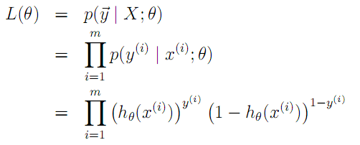
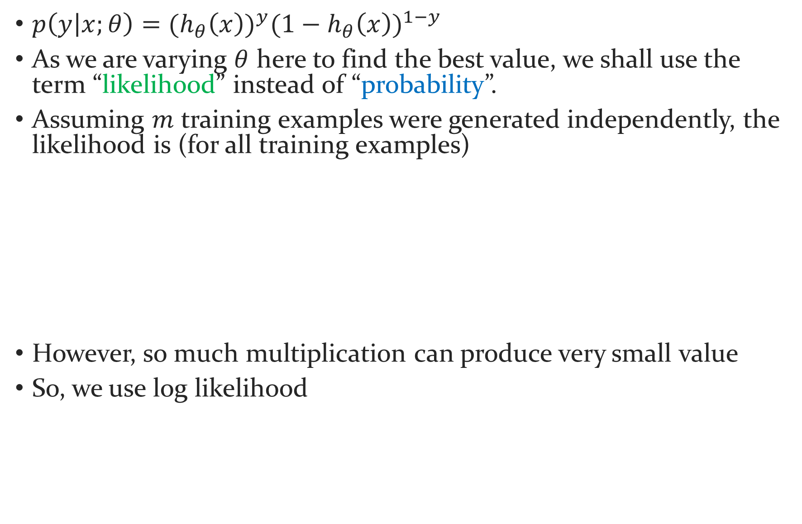
Maximizing the “Likelihood”
$p\left(y | x;θ\right)={(h_{θ}\left(x\right))}^{y}{({1−h}_{θ}\left(x\right))}^{1−y}$
As we are varying $θ$ here to find the best value, we shall use the term “likelihood” instead of “probability”.
Assuming $m$ training examples were generated independently, the likelihood is (for all training examples)
However, so much multiplication can produce very small value
So, we use log likelihood

Slide 14
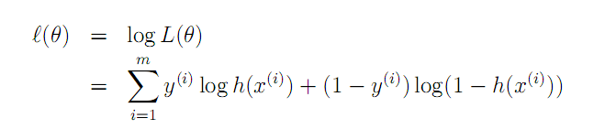
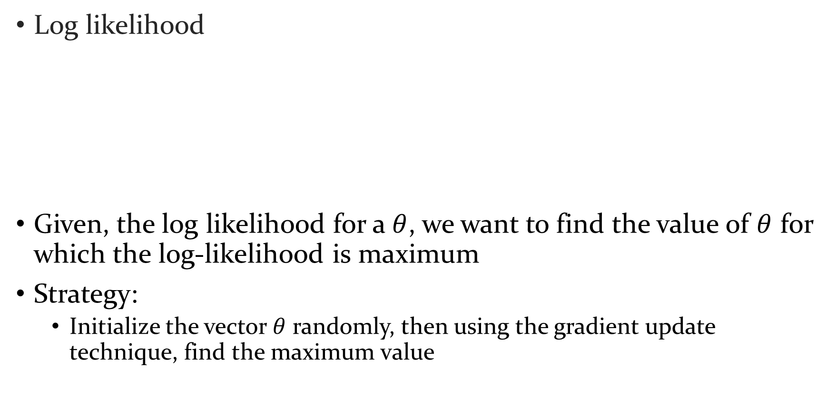
Maximizing the log-likelihood
Log likelihood
Given, the log likelihood for a $θ$, we want to find the value of $θ$ for which the log-likelihood is maximum
Strategy:
Initialize the vector $θ$ randomly, then using the gradient update technique, find the maximum value

Slide 15
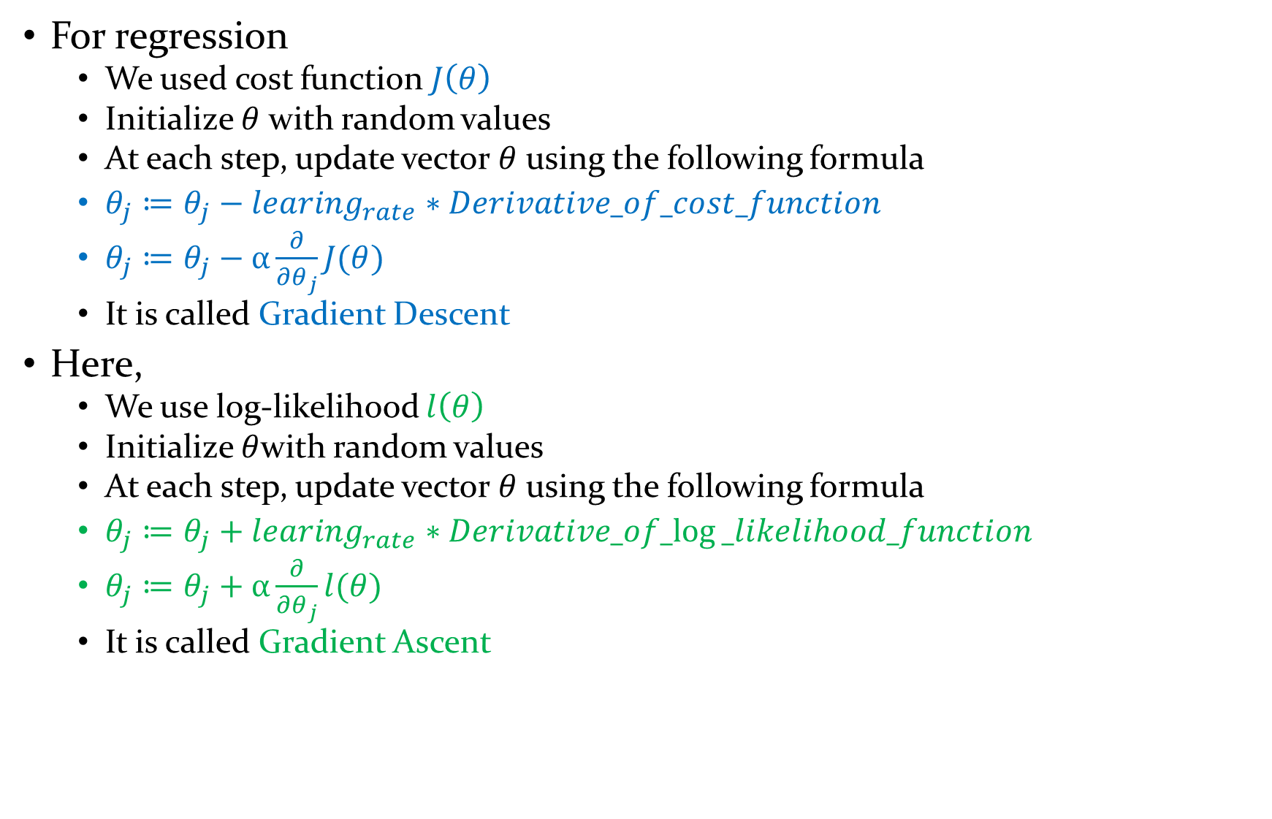
Maximizing the log-likelihood
For regression
We used cost function $J\left(θ\right)$
Initialize $θ$ with random values
At each step, update vector $θ$ using the following formula
$θ_{j}≔θ_{j}−learing_{rate}∗Derivative_of_cost_function$
$θ_{j}≔θ_{j}−α\frac{∂}{∂θ_{j}}J(θ)$
It is called Gradient Descent
Here,
We use log-likelihood $l\left(θ\right)$
Initialize $θ$with random values
At each step, update vector $θ$ using the following formula
$θ_{j}≔θ_{j}+learing_{rate}∗Derivative_of_log⁡_likelihood_function$
$θ_{j}≔θ_{j}+α\frac{∂}{∂θ_{j}}l(θ)$
It is called Gradient Ascent

Slide 16
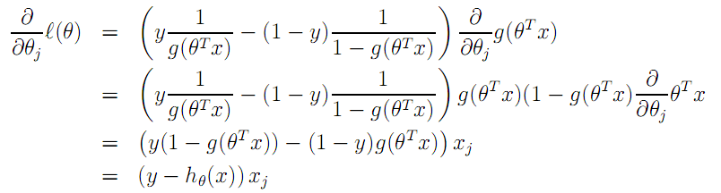
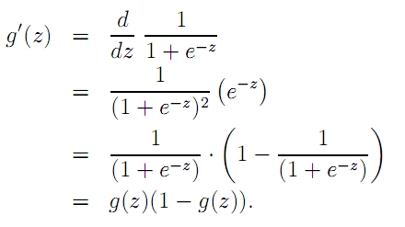

Maximizing the log-likelihood
$θ_{j}≔θ_{j}+α\frac{∂}{∂θ_{j}}l(θ)$
This was possible only because of the following nice property of Sigmoid function

Slide 17
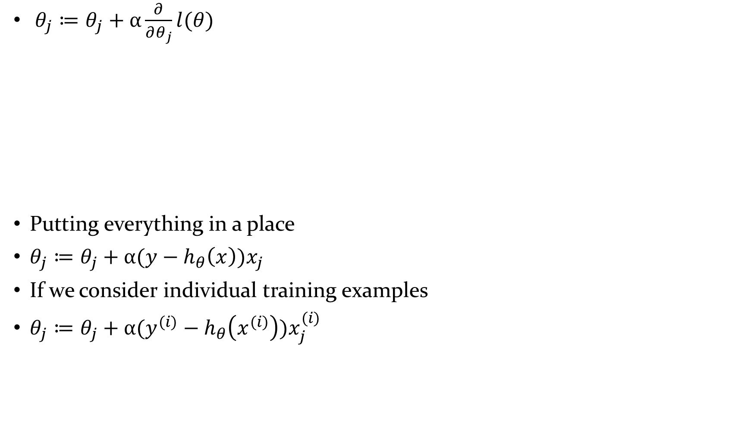
Maximizing the log-likelihood
$θ_{j}≔θ_{j}+α\frac{∂}{∂θ_{j}}l(θ)$
Putting everything in a place
$θ_{j}≔θ_{j}+α(y−h_{θ}\left(x\right))x_{j}$
If we consider individual training examples
$θ_{j}≔θ_{j}+α(y^{(i)}−h_{θ}\left(x^{(i)}\right))x_{j}^{(i)}$

Slide 18
References
CS229 Lecture Notes by Andrew Ng

